Slide 1

Leveraging Employee Satisfaction Metrics for Enhanced Stock Return Prediction and Portfolio Optimization
A performance study using Glassdoor reviews

Slide 2
Introduction
Overview of the project objective:
Goal: Construct a portfolio using employee satisfaction metrics.
Analyze how employee sentiments relate to stock performance.
Hypothesis: Companies with higher employee satisfaction are likely to perform better, potentially impacting stock performance positively.

Slide 3
Why Use Employee Satisfaction Metrics?
Unique Insight: Goes beyond financials to reveal company culture and management quality.
Performance Predictor: High employee satisfaction often correlates with strong stock performance..
Portfolio Differentiation: Adds a human-centric element that traditional metrics miss.
Aligned with ESG: Fits modern, socially responsible investment approaches.

Slide 4
Data Collection Methodology
Data sourced from Glassdoor reviews on Indian Stocks.
Data period starts from May 15, 2022.

Slide 5
Selection of Top Companies
Top 50 Companies: Selected based on the highest employee satisfaction scores.
Objective: To focus on companies with a substantial number of reviews and a strong satisfaction index.
Calculation OF EMPLOYEE SATISFACTION SCORE: Only reviews with positive ratings of 4 and above are considered.

Slide 6
Hypothesis
Ha = Alternative Hypothesis (Ha): Portfolio returns are less than market returns (μ_portfolio <= μ_market)
H0= Null Hypothesis (H0): Portfolio returns are greater than market returns (μ_portfolio > μ_market)

Slide 7

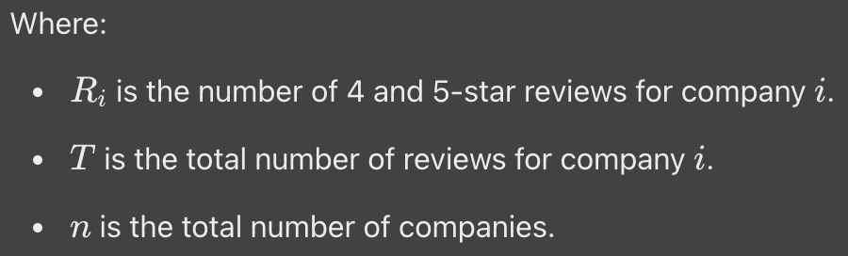
Employee Satisfaction Score Formula

Slide 8
Finalized Company List
List of the top 50 selected companies based on satisfaction scores.
Observation: Companies with a mix of industries are represented, reflecting a broad sample.

Slide 9
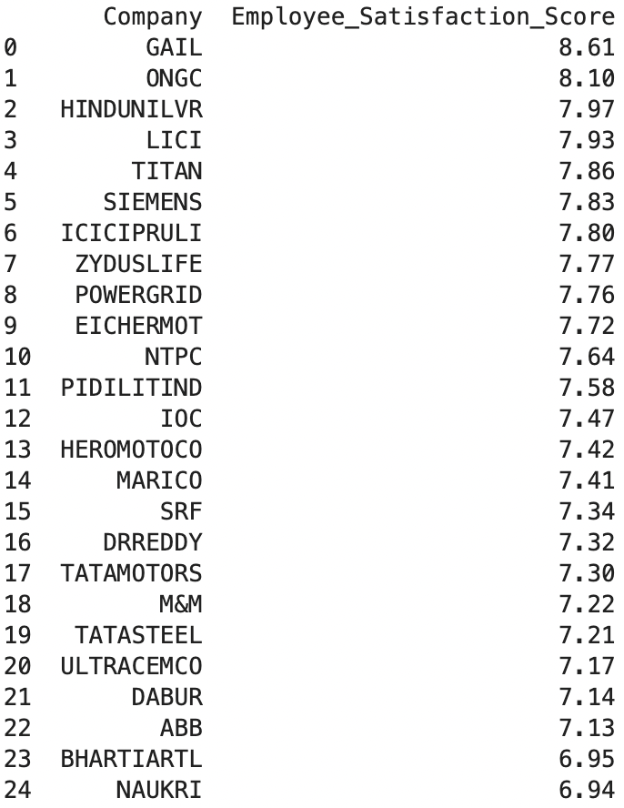
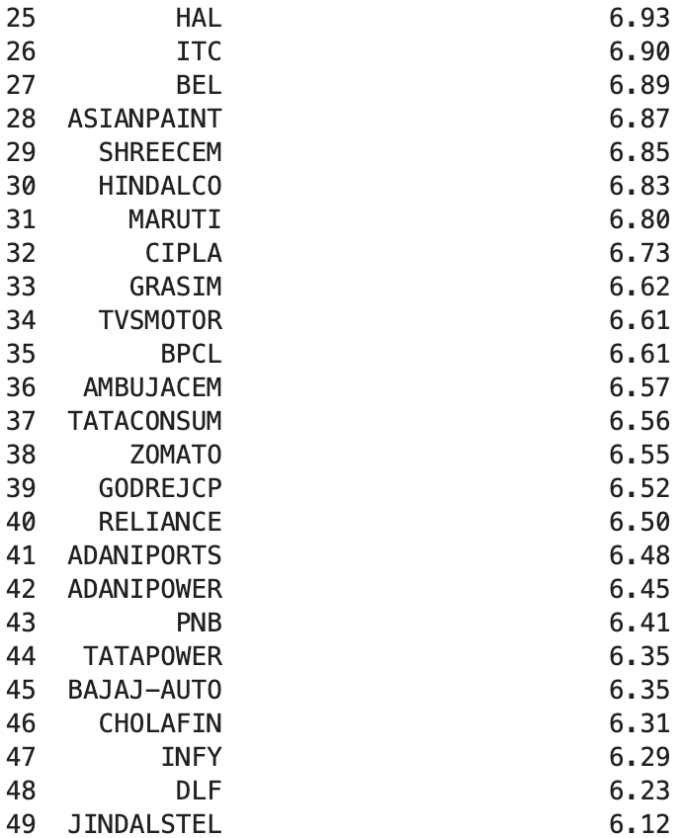
Finalised List of Top 50 Companies

Slide 10
Portfolio Weighting Strategy
Exponential Weighting: Weights were assigned based on employee satisfaction scores, with higher scores given higher weights.
Rationale: Emphasizes companies with high satisfaction, hypothesizing better performance.

Slide 11
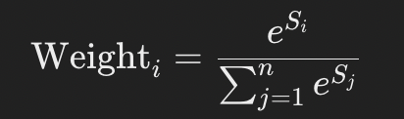
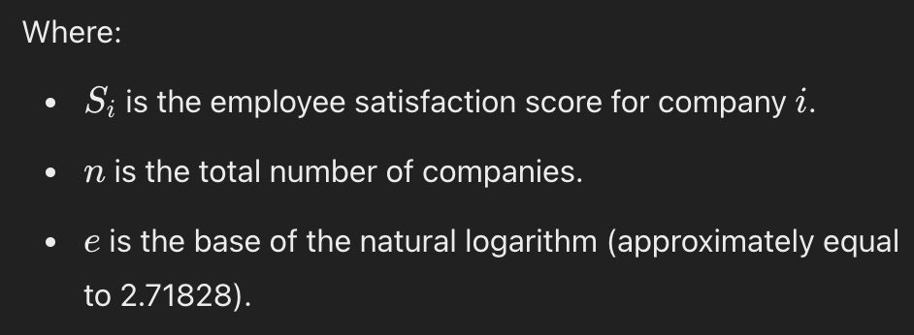
Portfolio Weighting Strategy

Slide 12
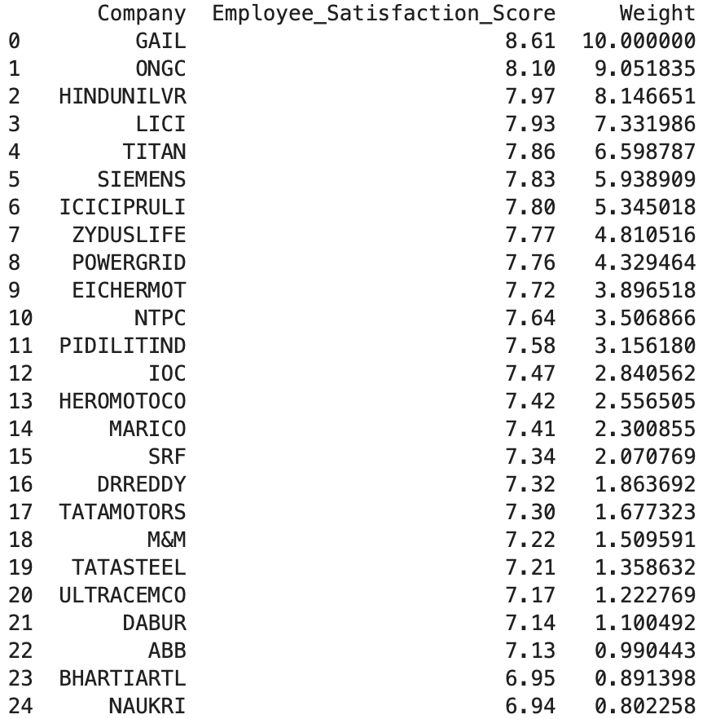
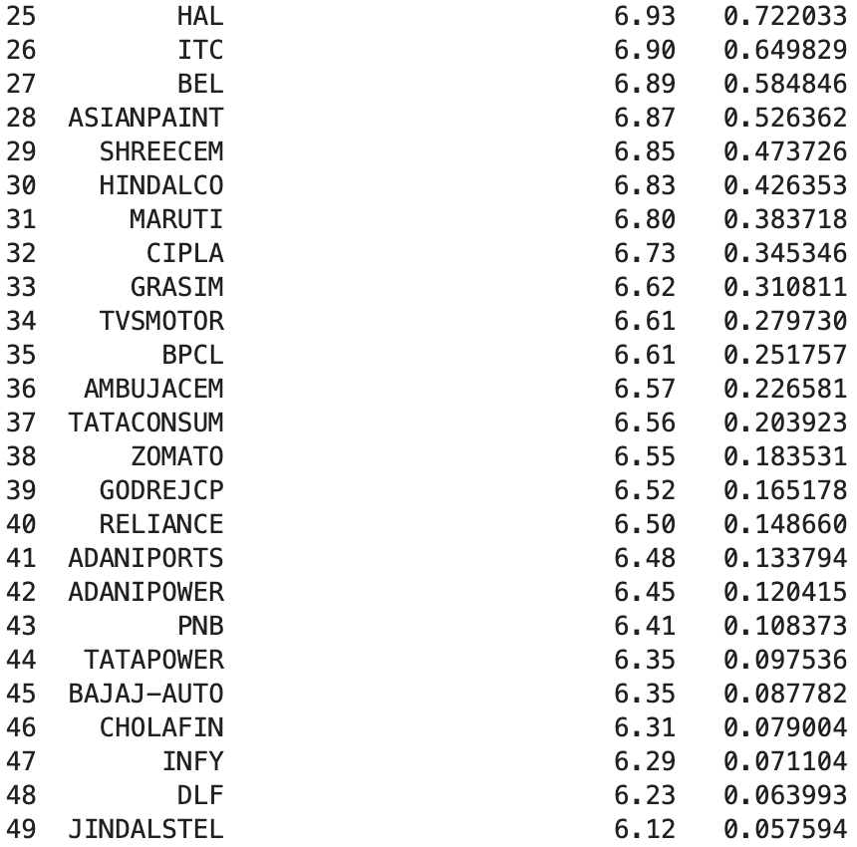
Portfolio Weights Visualization

Slide 13
Historical Price Data Collection
Source: Yahoo Finance used for daily stock price data.
Period: Data collected from May 15, 2022, to the latest date available for analysis.
Purpose: To calculate daily returns based on the assigned portfolio weights.

Slide 14
Benchmark Comparison – Nifty 50
Comparison of portfolio cumulative returns with Nifty 50.
Helps in assessing portfolio performance relative to the market.

Slide 15
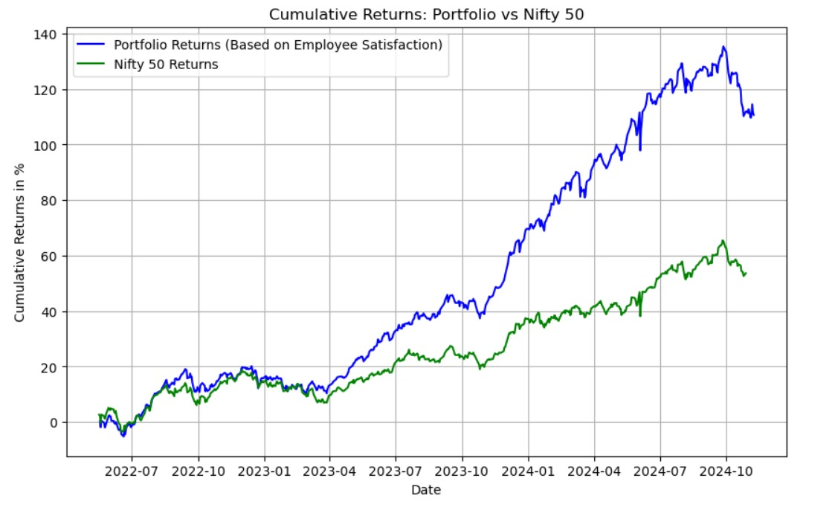
Benchmark Comparison – Nifty 50

Slide 16

Hypothesis Testing
Null Hypothesis (H0): Portfolio returns are greater than market returns (μ_portfolio > μ_market)
Alternative Hypothesis (Ha): Portfolio returns are less than market returns (μ_portfolio <= μ_market)
We got T- statistic and P- value as follows
We failed to reject the null hypothesis as p value is greater than 0.05. Portfolio returns are greater than market returns (μ_portfolio > μ_market)

Slide 17
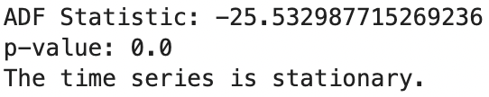
ARIMA FORECASTING
ADF Test for checking stationary/Non-Stationary
Since p value is less than 0.05. Time series is stationary.
∴ d=0
Arima(p, d=0,q)

Slide 18
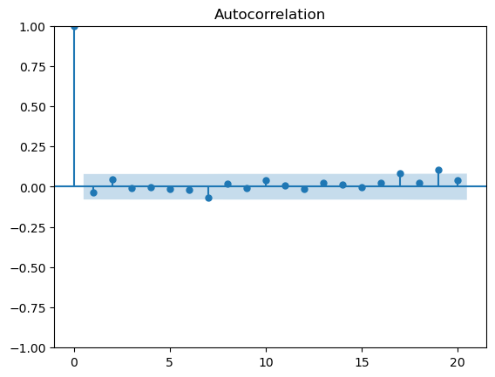
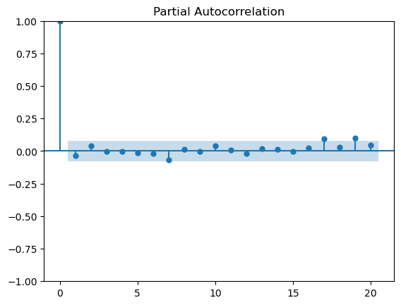
ACF & PACF Plots to identify viable ARIMA Model
q = 1
p = 1

Slide 19
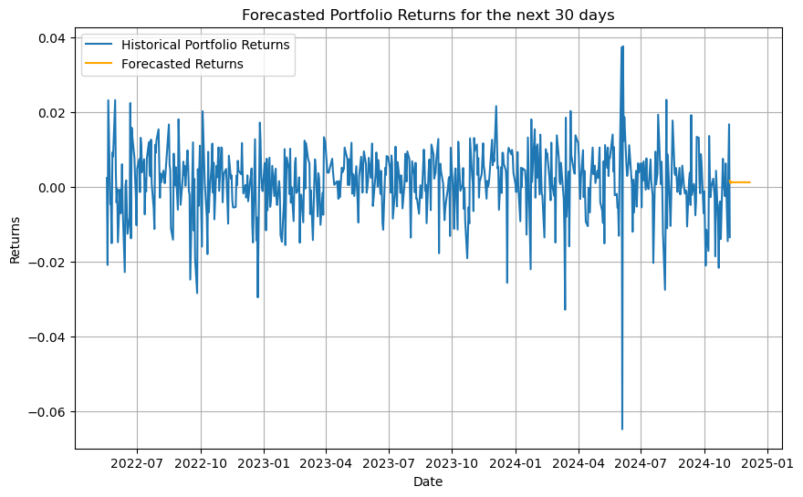
Forecasting Returns using ARIMA

Slide 20
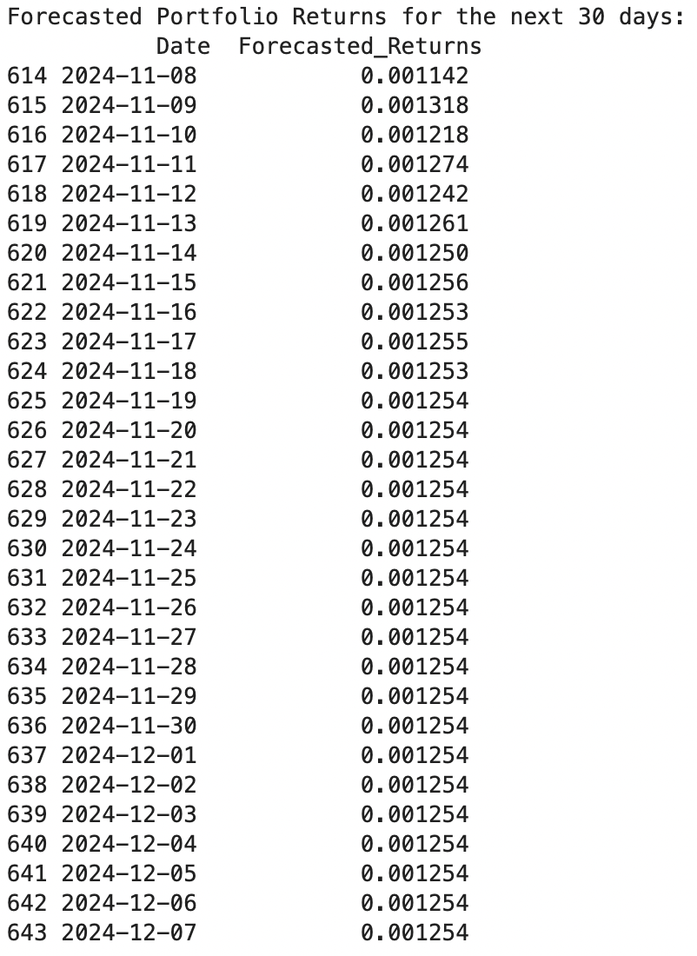
Forecasting Returns using ARIMA
As can see, we are getting same results from 19thNovember, 2024.
This ARIMA model is not reliable.
For more reliable forecast, we might have to consider more advanced models like LSTM.

Slide 21
Performance Metrics
Sharpe Ratio
Jensen’s alpha (α)
Treynor Ratio

Slide 22

Jensen’s Alpha Explanation
Definition: : Evaluates excess return over expected return based on CAPM
Purpose: Higher values indicate better risk-adjusted performance.

Slide 23
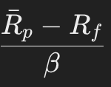
Treynor Ratio Explanation
Definition: Treynor Ratio: Measures risk-adjusted return per unit of market risk (beta)
Purpose: Higher values indicate better risk-adjusted performance.

Slide 24

Sharpe Ratio Explanation
Definition: Risk-adjusted return measure.
Purpose: Higher values indicate better risk-adjusted performance.

Slide 25
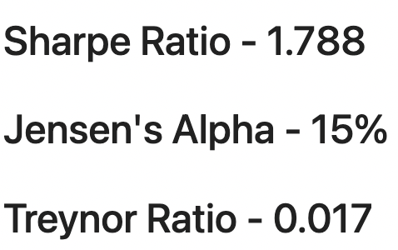
Portfolio Sharpe Ratio Results

Slide 26
Summary of Insights
Employee Satisfaction Impact: Companies with higher satisfaction show better portfolio performance.
Outperformance: Portfolio outperformed traditional benchmarks on risk-adjusted metrics.
Future Implications: Potential to use employee sentiment as a predictive factor in investing.

Slide 27
Data Limitations
NA Values: Some companies had missing (NA) values, impacting data completeness.
Review Quality Variability: Some data points may lack consistency in review quality.
Exclusion: Companies with significant NA values were excluded to maintain accuracy.

Slide 28
Conclusion & Next Steps
Employee Sentiment as a Factor: Demonstrates a viable approach for portfolio construction.
Further Research: Expand the dataset, include more sectors, or examine additional indices.
Considerations for Application: Future portfolios could use this approach to optimize returns.

